Slide 1
Chapter 2
Software Processes

Slide 2
Review
Introduction to SE
  Three Elements
    Methodology
    Tool
    Process

Slide 3
Objectives
To introduce software process models
To describe three generic process models and when they may be used
To explain the Rational Unified Process model
To introduce CASE technology to support software process activities

Slide 4
Topics covered
Software process models
Process iteration
Process activities
The Rational Unified Process
Computer-aided software engineering

Slide 5
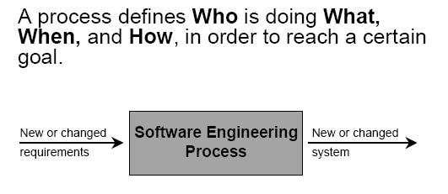
The software process

Slide 6
our process
vision
business modeling
requirements modeling
design modeling
implementation
test
deploy

Slide 7
The software process (continued)
A structured set of activities required to develop a software system.
There are many software processes, but some fundamental activities are common to all software processes:
  Specification;
    Requirement
  Design and implementation
  Validation;
  Evolution.

Slide 8
Generic software process models
A software process model is an abstraction representation of a process. It presents a description of a process from some particular perspective.
The waterfall model (software life cycle)
  Separate and distinct phases of specification and development.
Iterative development
  Specification, development and validation are interleaved.

Slide 9
Generic software process models (continued)
Component-based software engineering
  The system is assembled from existing components.
In practice, particularly for large system, these models are often combined (RUP)
There are many variants of these models e.g. formal development where a waterfall-like process is used but the specification is a formal specification that is refined through several stages to an implementable design.

Slide 10
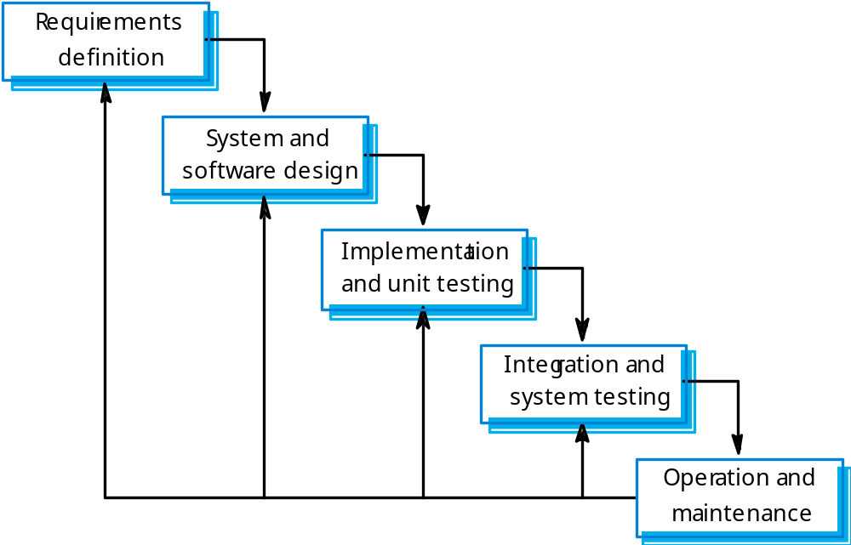
Waterfall model

Slide 11
Waterfall model phases
Requirements analysis and definition
System and software design
Implementation and unit testing
Integration and system testing
Operation and maintenance
The main drawback of the waterfall model is the difficulty of accommodating change after the process is underway. One phase has to be complete before moving onto the next phase.

Slide 12
Waterfall model problems
Key false assumption: requirement is stable
But : IKIWISI effect: I’ll know it when I see it.
Resultant product: deviate from user’s real requirements

Slide 13
Waterfall model problems (continued)
Inflexible partitioning of the project into distinct stages makes it difficult to respond to changing customer requirements.
Therefore, this model is only appropriate when the requirements are well-understood and changes will be fairly limited during the design process.
Few business systems have stable requirements.

Slide 14
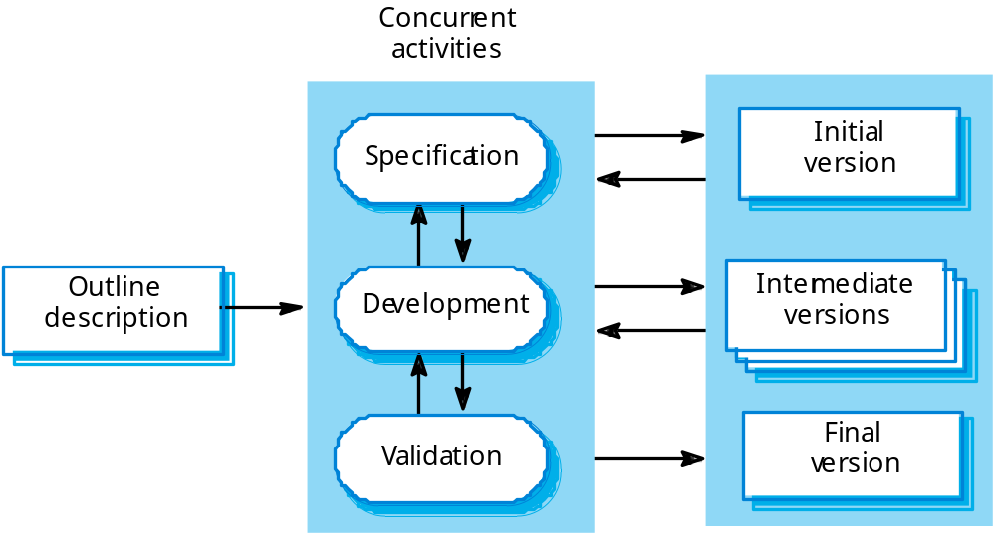
Iterative development (try marriage)
2/8 law

Slide 15
Iterative development (continued)
Evolutionary development is based on the idea of developing an initial implementation.
Exposing the version to user comment
Refining the version by user’s feedback
Iterative many versions until an adequate system has been developed.
Process activities are interleaved rather than separate, with rapid feedback across activities.

Slide 16
Evolutionary development versus waterfall
For a large system, a mixed process that utilizes each the best features:
Developing a throwaway prototype using an Iterative approach to resolve uncertainties in the system specification
Developing the well understood parts of the system using waterfall-based process.

Slide 17
Component-based software engineering
Reuse to reduce cost and risks, deliver fast.
Accidental reuse
Deliberately reuse :CBSE, relies an a large base of reusable components.
SOA, SASS: software as a service
Requirement compromises are inevitable.

Slide 18
Component-based software engineering (continued)
Based on systematic reuse where systems are integrated from existing components or COTS (Commercial-off-the-shelf) systems.
Process stages
  Component analysis;
  Requirements modification;
  System design with reuse;
  Development and integration.
This approach is becoming increasingly used as component standards have emerged.

Slide 19
Process activities
Software specification
Software design and implementation
Software validation
Software evolution

Slide 20
Software specification (Requirements engineering)
The process of establishing what services are required and the constraints on the system’s operation and development.
Requirements engineering process
  Feasibility study;
  Requirements elicitation and analysis;
  Requirements specification;
  Requirements validation.

Slide 21
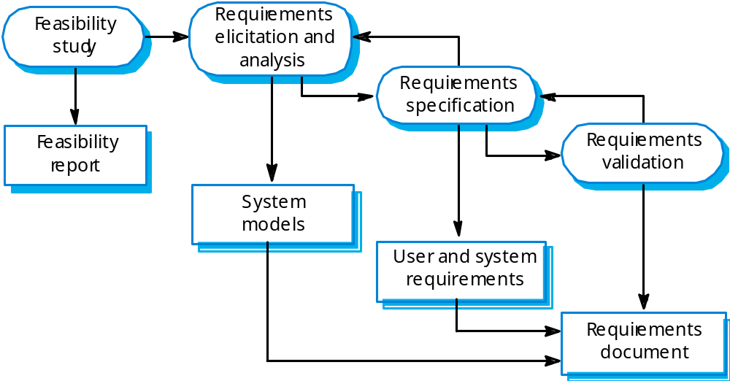
The requirements engineering process

Slide 22
Feasibility study
Mainly three aspects
  Technology
  Cost
  Social etc.
The result should inform the decision of whether to go ahead or stop
Should be relatively cheap and quick

Slide 23
Requirements elicitation and analysis
Elicitation
Analysis: What computer should do to reach stakeholder’s goal.

Slide 24
Requirements specification
Document for
  Customer or end-user oriented
  Software developer oriented

Slide 25
Requirements validation
Check for
  Realism
  Consistency
  Completeness
Correct the problems discovered in the activity

Slide 26
Software design and implementation
Software design
  Design a software structure that realises the specification;
  Decision, strategy
Implementation
  Translate this structure into an executable program;
The activities of design and implementation are closely related and may be interleaved.

Slide 27
Design process activities
Architectural design
Abstract specification
Interface design
Component design
Data structure design
Algorithm design
Practical process may adapt it in different ways.

Slide 28
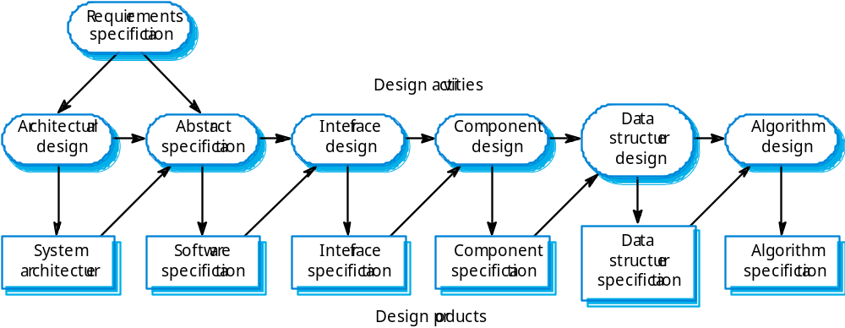
The software design process

Slide 29
Possible models in design process
The design is usually documented as a set of graphical models.
  Object model;
  Sequence model;
  State transition model;
  Structural model;
  Data-flow model.

Slide 30
Review
Process activities
  Business modeling
  Requirements analysis
  Design
  Implementation
  Test
  evolution
Process models
  Waterfall
  Iterative

Slide 31
Implementation- Programming and debugging
Translating a design into a program and removing errors from that program.
Programming is a personal activity - there is no generic programming process.
Programmers carry out some program testing to discover faults in the program and remove these faults in the debugging process.

Slide 32
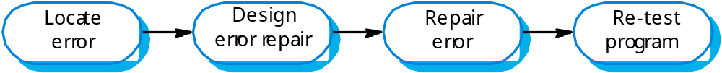
The debugging process

Slide 33
Software validation
Verification and validation (V & V) is intended to show that a system conforms to its specification and meets the requirements of the system customer.
Involves checking and review processes and system testing.
System testing involves executing the system with test cases that are derived from the specification of the real data to be processed by the system.

Slide 34
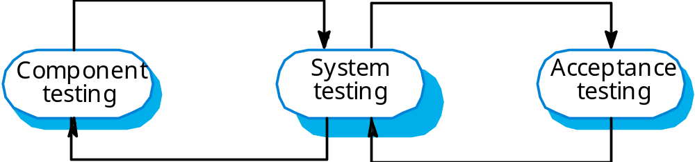
The testing process

Slide 35
Testing stages
Component or unit testing
  Individual components are tested independently;
  Components may be functions or objects or coherent groupings of these entities.
System testing
  Testing of the system as a whole. Testing of emergent properties is particularly important.
Acceptance testing
  Testing with customer data to check that the system meets the customer’s needs.

Slide 36
Testing stages
Acceptance testing : alpha testing
Beta testing: system is to be marketed as a software product. Delivering a system to a number of potential customers to test.

Slide 37
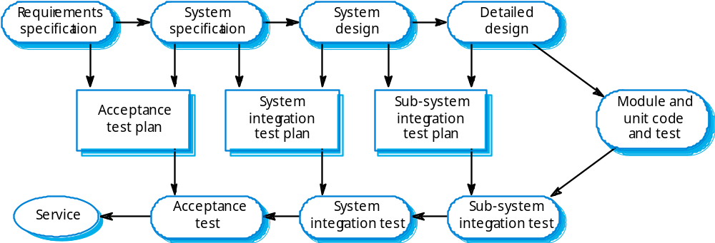
Testing phases

Slide 38
Software evolution
Software is inherently flexible and can change.
As requirements change through changing business circumstances, the software that supports the business must also evolve and change.

Slide 39
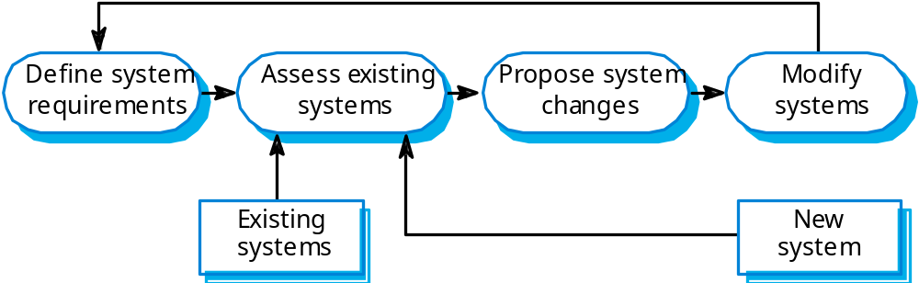
System evolution

Slide 40


Slide 41
The Rational Unified Process
IBM Rational
A hybrid process model: best practices
Modern: OO based
A process model derived from the work on the UML and associated process.
Normally described from 3 perspectives
  A dynamic perspective that shows phases over time;
  A static perspective that shows process activities;
  A practice perspective that suggests good practice.

Slide 42
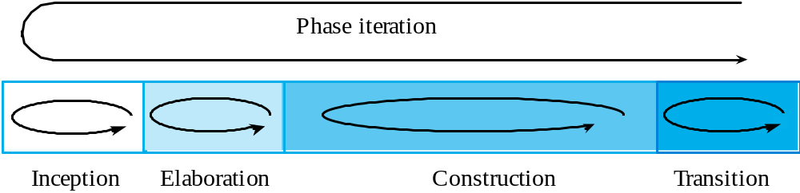
RUP phase model

Slide 43
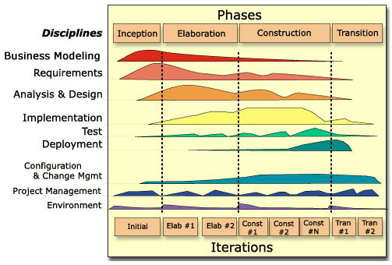

Slide 44
RUP phases
Inception: focus on feasibility
  Establish the business case for the system.
Elaboration: focus on requirements
  Develop an understanding of the problem domain and the system architecture.
Construction: focus on design
  System design, programming and testing.
Transition
  Deploy the system in its operating environment.

Slide 45
RUP good practice
Develop software iteratively (r priority)
  The most difficult part has top priority(先做最难做的事情）2/8 law
Manage requirements
Use component-based architectures
Visually model software
Verify software quality
Control changes to software

Slide 46
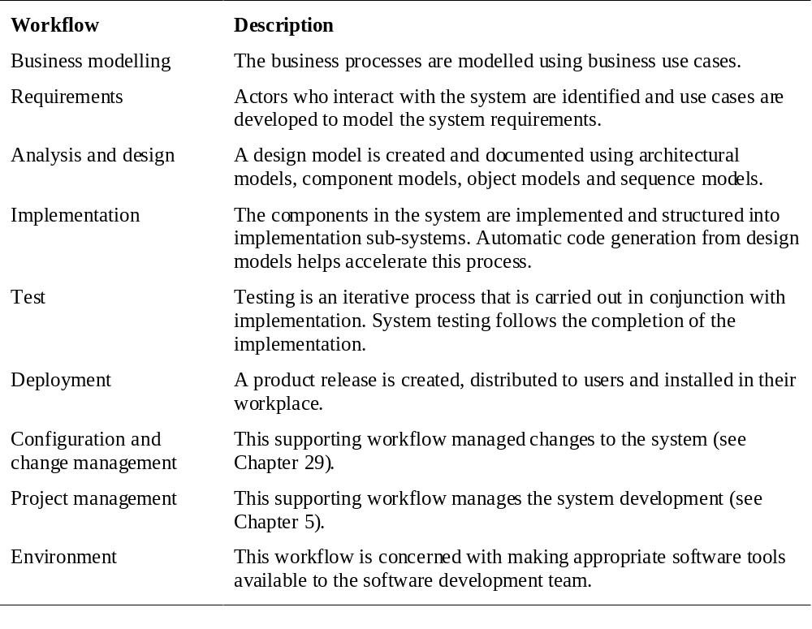
Static workflows

Slide 47
Computer-aided software engineering
Computer-aided software engineering (CASE) is software to support software development and evolution processes.
Activity automation
  Graphical editors for system model development;
  Data dictionary to manage design entities;
  Graphical UI builder for user interface construction;
  Debuggers to support program fault finding;
  Automated translators to generate new versions of a program.

Slide 48
CASE technology
CASE technology has led to significant improvements in the software process. However, these are not the order of magnitude improvements that were once predicted
  Software engineering requires creative thought - this is not readily automated;
  Software engineering is a team activity and, for large projects, much time is spent in team interactions. CASE technology does not really support these.

Slide 49
CASE classification
Classification helps us understand the different types of CASE tools and their support for process activities.
Functional perspective
  Tools are classified according to their specific function.
Process perspective
  Tools are classified according to process activities that are supported.
Integration perspective
  Tools are classified according to their organisation into integrated units.

Slide 50
CASE integration
Tools
  Support individual process tasks such as design consistency checking, text editing, etc.
Workbenches
  Support a process phase such as specification or design, Normally include a number of integrated tools.
Environments
  Support all or a substantial part of an entire software process. Normally include several integrated workbenches.

Slide 51
Note
CASE helps professionals productive but turns a novice into a novice.
such as computer mouse.

Slide 52
Key points
Software processes are the activities involved in producing and evolving a software system.
Software process models are abstract representations of these processes.
General activities are specification, design and implementation, validation and evolution.
Generic process models describe the organisation of software processes. Examples include the waterfall model, evolutionary development and component-based software engineering.
Iterative process models describe the software process as a cycle of activities.

Slide 53
Key points
Requirements engineering is the process of developing a software specification.
Design and implementation processes transform the specification to an executable program.
Validation involves checking that the system meets to its specification and user needs.
Evolution is concerned with modifying the system after it is in use.
The Rational Unified Process is a generic process model that separates activities from phases.
CASE technology supports software process activities.

